Slide 1
Understanding Data and Information Flow
Module 3
Notes:
One of the first steps in facilitating the use of data is to understand how data and information flow from data collectors to users, including all steps of analysis, storage, and dissemination in between.

Slide 2
Session Objectives
Identify opportunities for improving data production and use
Identify opportunities for feedback mechanisms
Identify points where analysis & data could support programmatic decision making
Notes:
By the end of this session, the learner will be able to:
NOTE to facilitator: Read slide.

Slide 3
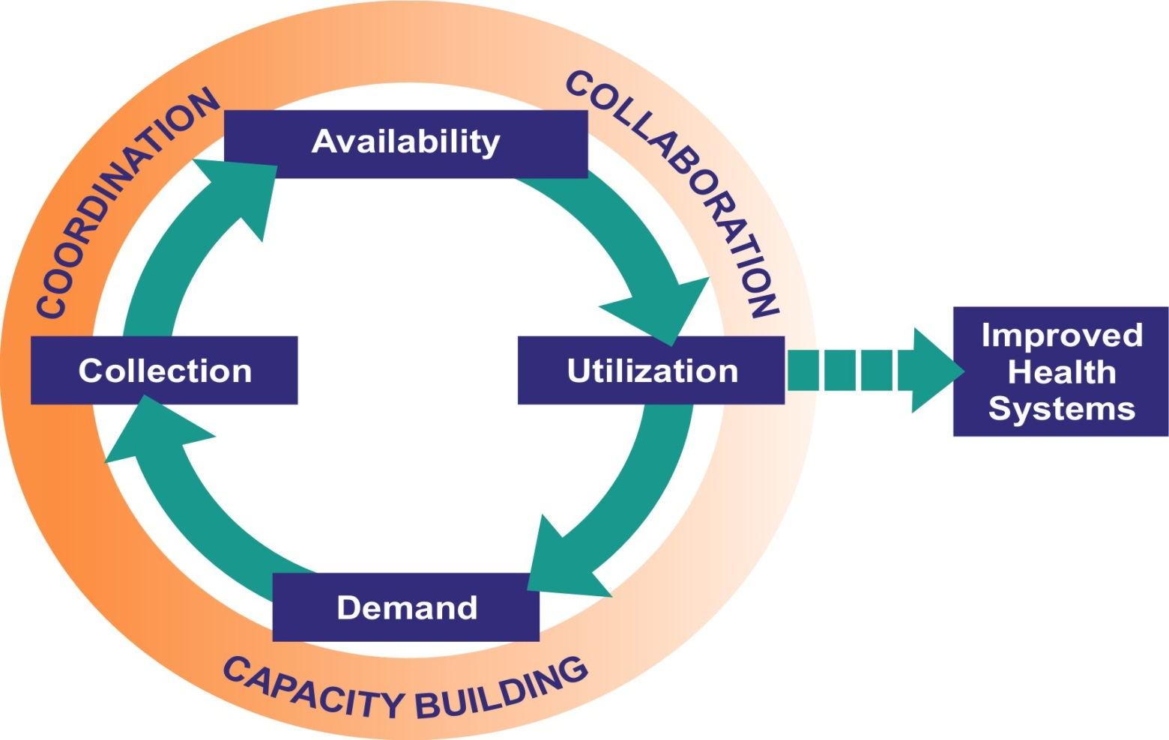
Data Demand & Use
Notes:
In earlier Data Use sessions, we discussed the data demand and use conceptual framework. As mentioned earlier, this framework depicts the cycle of data demand, collection, availability, and use inherent to monitoring and evaluation. The overarching principle of the framework is that evidence-based decision making will promote the achievement of improved health outcomes. This slide presents the MEASURE Evaluation data demand and use conceptual framework as a cycle from demand to utilization (which directly affects demand); embedded in the cycle is the decision-making process.
In this session, we will focus in on Availability, shown at the top of the diagram. Here data are transformed into a format that can be easily understood by the user and are disseminated to the end user. It is important that the decision maker understands information needed to inform the decision; the Information Use Map highlighted in this section will help align available information with decisions.
NOTE to facilitator: As you discuss the cycle again, bring up the barriers the group already has discussed to show how each barrier can interrupt the process at various points in this cycle. Emphasize the need to address barriers to data use.

Slide 4
Purpose of Understanding Data Flow
Helps us better understand our role in health information system and importance of collecting data
Identify opportunities for improving data collection and analysis, increase availability, and ensure its use
Notes:
The simple process of graphically charting information flow, using such formats as an Information Use Map, helps participants better understand their role in the greater health information system—and the importance of collecting data in the first place. When people can see the value, they become more committed to consistent, sustainable, high-quality data collection and to regular analysis of those data.
Charting the flow of data and information will allow us to identify opportunities for improving data collection, analysis, increase availability, and ensure the use of data. We can graphically represent the flow of data and information at any level.

Slide 5
Information Flow
Program
Managers, Government Donors
Feedback
Reports
Clinical Histories, Service Statistics
Compiled Data
Analysts, evaluators
Higher levels: district, province, national
Service Delivery Point
Notes:
This flowchart shows how data can flow effectively from the service delivery level to the higher levels responsible for supervision of programs such as the district, province, and national levels.
You see in the set of boxes on the left that data are collected at the service delivery point for a specific program area. Data are compiled from clinic histories and service statistics and passed to higher levels (set of boxes on the right) for aggregation and use in reporting and hopefully, decision making. Before data are passed to the higher level, they are ideally presented to program managers, directors, and service providers within the facility or organization for their own use in programmatic decision making.
Feedback (as represented by the pink arrow) is an essential part of the information flow process. Reports produced by the higher levels should be shared with service delivery points and organizations to ensure that they are familiar with how other service providers are performing (DOWN the information hierarchy). In addition, the higher level can provide guidance and advice to facilities on an individual level based on the data they receive.
However, this is not always the case.

Slide 6
Reasons to Assess Information Flow
Local data not used locally
Higher-level information does not return back to local level
Local data not assessed in broad context
Little incentive to produce high-quality data
Notes:
Why is this not the case? Why do data and information often not flow as they should? The scenarios listed on this slide are typical:
Local data are not being used locally. Often, data are tallied and reported up the levels but are rarely analyzed and used to support mid-course corrections at the level at which they were generated. In many situations, data could be used to investigate trends over time, compare different areas, set priorities and goals for future years, compare progress against defined goals, and advocate for funding or policies.
Higher-level information does not return back to the local level. Consider the example of a family planning clinic, where data reveal a declining trend in use of oral contraception. The providers knew that women complained about the side effects, but they did not know how much the overall contraception rates were being affected. The district and regional officers knew contraception rates were declining but did not know why. There was a need to bring these information sources and stakeholders together.
Local data are not assessed in broad context. For example, suppose 10 percent of the population in the region is expected to receive a service, and one district is reaching only 2 percent. Obviously, there is a large service coverage gap in this district—but the facilities and district office would not necessarily know it, because they may not be aware of how their service delivery rates compare to regional objectives.
There is little incentive to produce high-quality data. People involved in local-level data collection efforts often do not see the purpose in collecting the data. They have a difficult time appreciating their role in the larger context of the health information chain and, as a result, may spend less energy in collecting the data and paying attention to detail.
Since there is such a large amount of money and effort being devoted to collecting data and reporting in health information systems, it only makes sense to maximize the impact of those data for real-world benefit. This is where the Information Use Map is so valuable.

Slide 7
Investigating Information Flow in Dominica
Situation: local health centers and hospitals report up through the RHIS system.
Problem: local facilities never receive full reports after they are completed.
Information Use Map Suggestions: identified opportunities for feedback to facilities and specified how the information could be used for mid-course corrections.
Notes:
Let’s look at an example of how mapping information flow in Dominica improved information flow and ultimately data use.
In Dominica, local health centers and hospitals sent information to their superiors about the number of people they tested for HIV/AIDS, while labs sent test results. A statistician in the Health Information Unit aggregated the data and sent a quarterly report to the Ministry of Health, which in turn sent a quarterly report to the Caribbean Epidemiology Center (CAREC) and an annual report to the Prime Minister.
The trouble was that local facilities never got these reports. They didn’t know how they compared to other facilities or to national trends and goals. Were they on track with their programs or not?
These information gaps quickly became apparent when data collection, analysis, and use processes were visualized in an Information Use Map. Data were reported but not used. Reports did not get back to the providers of source data. The mapping exercise identified ways the Health Information Unit could share its insights down the line, which would lead to mid-course improvements in pre-test counseling and greater acceptance of HIV/AIDS testing.

Slide 8
Group Participation
How does information flow through your organization?
Notes:
Let’s take a moment to discuss how information flows through your organizations.
NOTE to facilitator: Encourage participants to contribute to the question in plenary. Record the participant responses on a flip chart.

Slide 9
Information Use Map
Notes:
Now that you have had some experience in discussing how information flows in your work settings, let’s review the Information Use Map, a tool that can be used to formally map information flow, and ultimately link available data with decisions that need to be made.

Slide 10
Information Use Mapping
Purpose
Describe existing flow of health information to identify opportunities for improving its use
Description
Identifies gaps and opportunities for using information
Identifies opportunities for additional feedback mechanisms
Identifies points where analysis & data could support programmatic decision making
Notes:
The Information Use Map is a flowchart framework that allows the user to:
Create a schematic representation of the existing state of a health information system or subsystem.
Through this visual representation, quickly identify gaps and deficiencies in that information flow.
Identify opportunities for new feedback mechanisms to share high-level analysis and reports with lower levels of the information hierarchy.
Identify points in the process where additional analysis and use of data could lead to improved programs.
Prioritize recommendations and formulate an action plan to implement them.
The Information Use Map can be developed and applied at the international, regional, national, or local levels. The map can be an ongoing guideline to assess progress toward the “expected” future vision of the map. The Information Use Map can also become a standard part of an M&E system—revisited and revised at regular intervals or whenever a new survey or special study is being designed.

Slide 11
Notes:
NOTE to facilitator: Provide handout of map to participants.
Here is a snapshot of the Information Use Map.
The rows represent the different actors in the health system that collect and use data. The row starts with private clinics, NGOs, government facilities, regions and finally, the national level. Data are collected at the first three levels and then passed to the last two levels for use.
The columns represent the process that data goes through from collection to compilation, storage, analysis, reporting, and use.
The map shows where data from the different data collection points pass through the stages of collection to use. When information flow is mapped visually, deficiencies quickly become apparent. Large, empty expanses of the chart tell the story. In this map, it is clear that insights from high-level reports are not shared back with lower levels, and information is only being used to file reports, not to support evidence-based decisions for program improvements.

Slide 12
Notes:
NOTE to facilitator: Provide handout of map to participants.
This map highlights potential improvements in the M&E system where feedback mechanisms can be developed and opportunities for increased data use can be identified.
The mapping process shows how each level of service delivery can improve its use of the data it has for local decision making, as indicated by the circles. Also, the map shows how the data collected at the facility level contribute to national data systems and the decision-making process. The arrows along the left-hand side show how data are shared back with those that collect the date to improve feedback and monitoring of services delivered.

Slide 13
Key Messages
Actual flow of data and information can reveal barriers to improving data quality and use
Information Use Map can highlight intervention points
Notes:
We are going to move on to a small group activity. Before we do, let’s review the key messages of this session.
NOTE to facilitator: Read slide and solicit questions on the material covered.

Slide 14
Small Group Activity 4: Part 1 Instructions
Convene in a small group by organization
Complete the Information Use Map for your organization as data flow now
Activity time: 30 minutes
Notes:
NOTE to facilitator: If participants are not from the same organization, this activity can be done with participants from different organizations, but have each group choose one organization to map for the exercise. Convene groups of six to eight individuals. Read the slide. Hand out copies of the Information Use Map. Each group should spend approximately 30 minutes mapping how information flows in their organization. After 20 minutes of group work, remind the groups that they have 10 more minutes to finish Part 1.

Slide 15
Small Group Activity 4: Part 2 Instructions
Review the map and discuss among your group how the flow of information could be improved:
How else could data be analyzed?
Are there opportunities for feedback mechanisms?
Are data being used by all stakeholders?
Note potential interventions based on your discussion.
Make a 2nd version of the map to illustrate an improved flow of information.
Activity time: 30 minutes
Notes:
NOTE to facilitator: Read slide.

Slide 16
If you finish early…
Summarize the best practices or corrections that you are suggesting
Discuss and share why these changes or best practices would facilitate use of the data
Notes:
NOTE to facilitator: Read slide.

Slide 17
Small Group Activity: Report Back
One group member remains at the table to present the map to visitors.
Each table group moves to the right to visit the table next to them.
The table presenter spends 5 minutes explaining how his/her group improved information flow in its map and how this would facilitate use of data.
Repeat steps 2–3.
Everyone returns to original tables.
Consider improving your map based on what you learned from your neighbors.
Time: 1 hour
Notes:
NOTE to facilitator: To report back on this exercise, we will use a ‘round robin’ approach. Instruct one group member to remain at the table to present his/her map to visiting tables. Each table group (minus the presenter, who remains behind) moves to the right to visit the table next to them. Table representatives spend 10 minutes describing to visitors how his or her group improved its information flow and how this would facilitate data use. After 10 minutes, the table group moves one more table to the right and visits a new table. The table representative again spends 10 minutes describing to visitors how the table improved its information flow and how this would facilitate data use. All table groups return to their own tables to consider and discuss how what they learned from their neighbors could be applied to their settings to improve information flow and data use. Remind the group that they have 30 minutes to improve their maps after they have visited with their neighbors.

Slide 18
THANK YOU!
MEASURE Evaluation is a MEASURE project funded by the U.S. Agency for International Development and implemented by the Carolina Population Center at the University of North Carolina at Chapel Hill in partnership with Futures Group International, ICF Macro, John Snow, Inc., Management Sciences for Health, and Tulane University. Views expressed in this presentation do not necessarily reflect the views of USAID or the U.S. Government. MEASURE Evaluation is the USAID Global Health Bureau's primary vehicle for supporting improvements in monitoring and evaluation in population, health and nutrition worldwide.
Visit us online at http://www.cpc.unc.edu/measure

