Slide 1
OVC_HIVSTAT
HIV Risk Assessment Prototype

Slide 2
HIV Risk Assessment prototype
Background
In the current climate of limited resources, there is a desire to reduce overall testing costs while strategically targeting testing to those most likely to test HIV-positive.
As part of that push, the Office of the Global AIDS Coordinator (OGAC) recommends that an HIV Risk Assessment be applied to all children whose HIV status is unknown, to identify children at risk for HIV infection and subsequently ensure that they are tested.
In addition, implementing partners (IPs) should play a key role ensuring that HIV-positive children are successfully linked to and retained in treatment and care.

Slide 3
HIV Risk Assessment prototype
Introduction
After reviewing many IP HIV risk assessment tools, MEASURE Evaluation noticed key issues with how data were captured and organized.
MEASURE then developed an HIV Risk Assessment prototype that IPs may adapt to assess risk among orphans and vulnerable children (OVC).
The purpose of the prototype is to improve the quality of data collected for reporting to the Data for Transparency and Impact (DATIM) system of the United States President’s Emergency Plan for AIDS Relief (PEPFAR).
Efforts are ongoing to study the appropriate mix and type of risk questions, to enhance the ability of case workers to refer the children whose risk is highest.

Slide 4
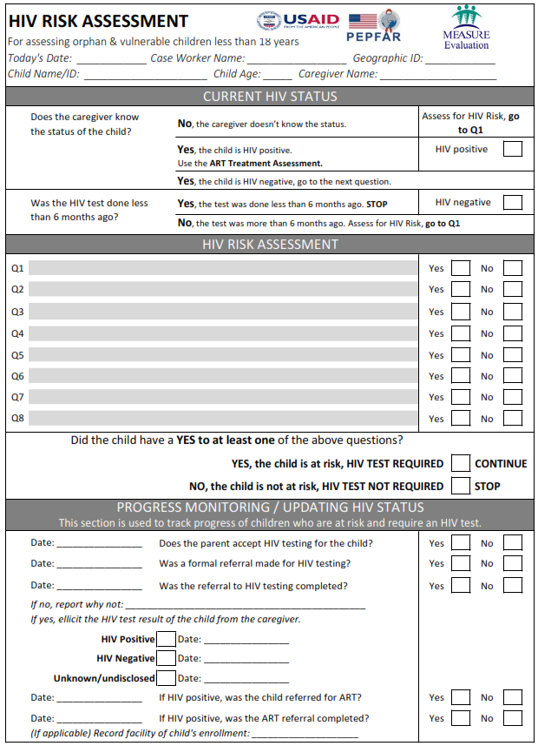
HIV Risk
Assessment prototype
Suggested template that can be modified for use by IPs
IPs will add their own risk assessment questions (gray boxes)
Ideal if all IPs in one country are using the same tool

Slide 5
HIV Risk Assessment prototype
Intended use
This HIV Risk Assessment is intended for OVC under 18 years of age for reporting data on PEPFAR’s OVC_HIVSTAT indicator and is entirely customizable.

Slide 6
HIV Risk Assessment prototype
Current HIV status
Determine whether or not the caregiver knows the HIV status of the child.
For HIV-positive children, the Antiretroviral treatment (ART) Assessment is conducted separately.
Determine whether or not HIV-negative results were reported within the past 6 months.

Slide 7
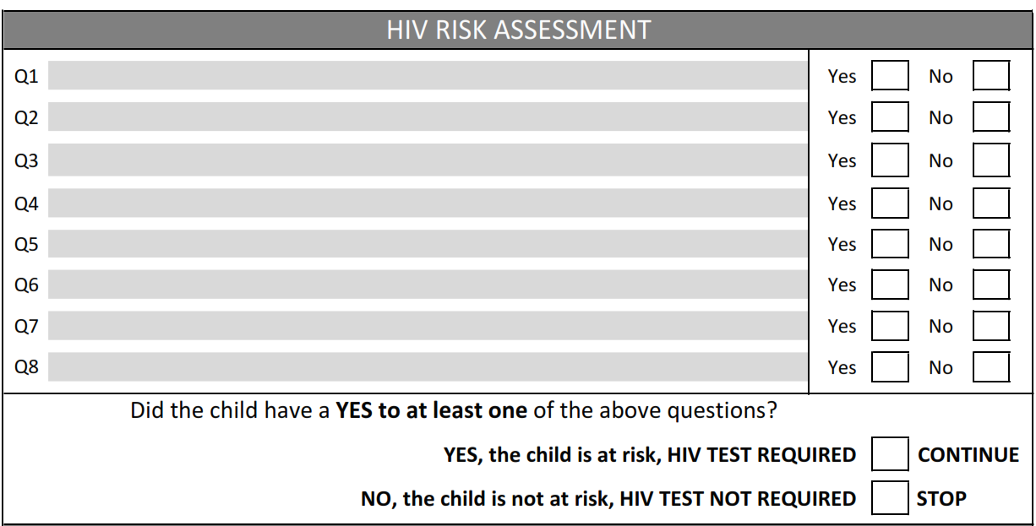
HIV Risk Assessment prototype
HIV risk questions
HIV risk questions are to be added as appropriate.
Suggest simple logic: If the answer to at least one question is yes, then the child is considered to be at risk.
Note clear labeling of the outcome of the risk assessment.
Suggested Q1: Does the child have an HIV-positive parent or sibling?

Slide 8
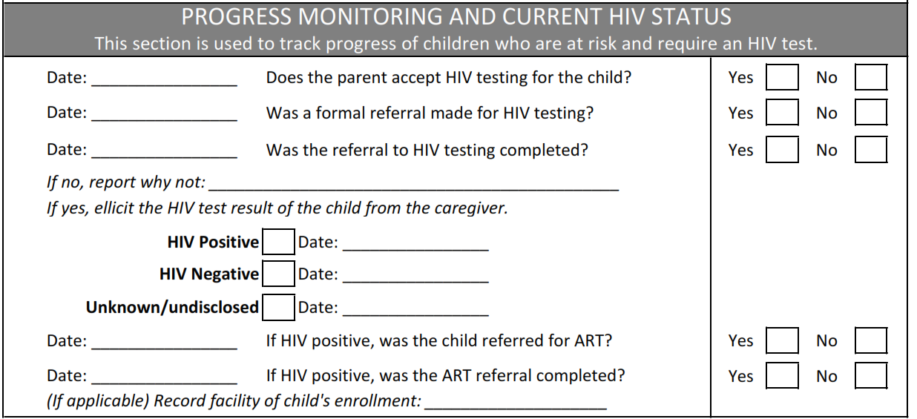
HIV Risk Assessment prototype
Progress monitoring and new HIV status
Gather information on the next steps for monitoring and recording a new HIV status after the HIV Risk Assessment.
Encourage attaching the date to each key step.
Consider tracking two types of HIV status: original and current.

Slide 9
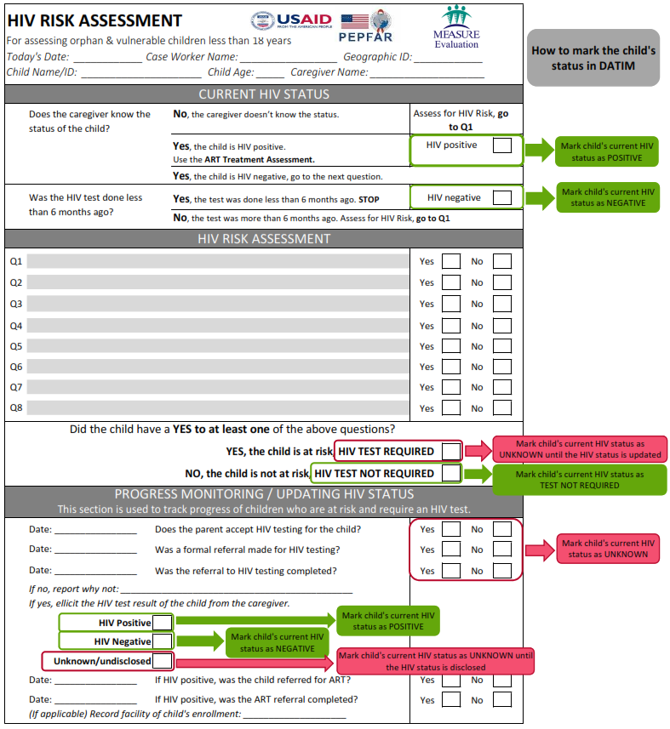
HIV Risk Assessment prototype
Data entry
This data entry map helps data entry clerks know what results on the form correspond to which DATIM categories.
Red fields map to “HIV status unknown.”
Green fields map to “HIV positive,” “HIV negative,”, and “test not required.”

Slide 10
HIV Risk Assessment prototype
Data entry: Original HIV status
If the caregiver doesn’t know the HIV status of the child or the child had an HIV-negative test done more than 6 months ago
If the caregiver knows the status of the child and the child is HIV-positive
If the caregiver knows the child had an HIV-negative test less than 6 months ago
Conduct the risk assessment starting with the first question. No data entry in this section.
Mark child's current HIV status as POSITIVE
Mark child's current HIV status as NEGATIVE

Slide 11
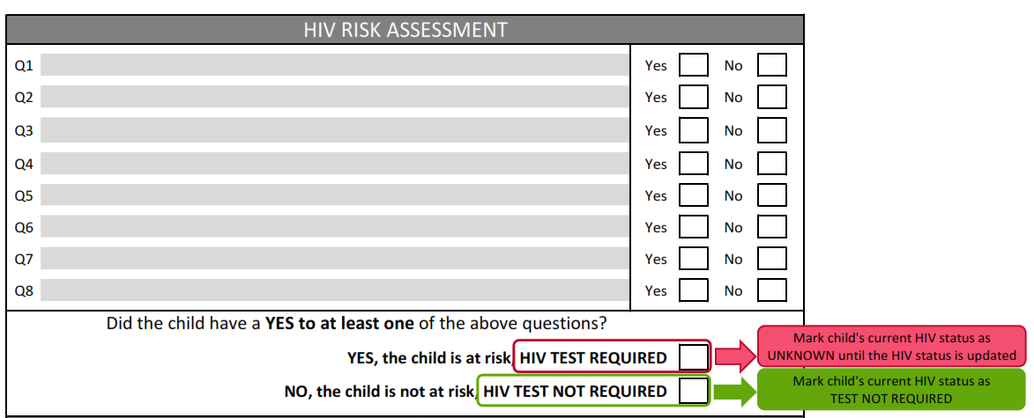
HIV Risk Assessment prototype
Data entry: HIV risk assessment
If the child is determined to be at risk but the test results are not yet reported. . .
If the child is not at risk
Mark child's current HIV status as TEST NOT REQUIRED

Slide 12
HIV Risk Assessment prototype
Data entry: Progress monitoring and current HIV status
If the child has been referred for testing, but the test results are not yet reported. . .

Slide 13
HIV Risk Assessment prototype
Data entry: Process entry and current HIV status
If the child has completed an HIV test and results are reported…
If the child has completed an HIV test, but the test results are not yet reported or disclosure is refused. . .
Mark child's current HIV status as Positive OR Negative

Slide 14
Best practices
for adapting the HIV Risk Assessment prototype
Include only risk factors that require testing.
Use a simplified form structure that has clear selection options for yes and no after each question and a clear location to mark the result.
Keep the assessment to one page per child.
On the same one-page tool, include next steps and follow-up after administering the assessment.
Notes:
1. If the answer to any one risk assessment question is yes, testing is recommended. Case workers often have a high school level of education or less, and complicated math formulas to determine risk status increase the risk of error.
2. Be sure to indicate clearly whether the child require a test or not? Limit confusion and error when case workers and their supervisors are reviewing forms; to help data entry clerks when transferring data to electronic databases
3. Maximization of resources; reduction of paperwork for case workers potentially walking hours to get to homes
4. Case workers and programs currently try to track HIV test referrals and their completion and disclosure of a new HIV status in various places—capturing referrals in aggregated referral tracking books, returning to enrolment forms to update HIV status, etc. It is in the best interest of the child and for M&E monitoring purposes that this information be collated in one paper form, therefore facilitating better case management at the household level, as well as easier transfer of information into electronic databases

Slide 15
HIV Risk Assessment prototype
Conclusion
IPs are encouraged to collect internal monitoring data to ensure that they continually improve linkage to HIV testing services for those children most at risk of infection.
Children drop off the HIV risk assessment continuum at multiple stages. All children who drop off should be reported under OVC_HIVSTAT as “HIV status unknown.”

